Slide 1
Population Viability
Population growth, age structure, stochastic effects, viability simulations and minimum viable populations.

Slide 2
Excerpt from: Ivory-billed Ghost Birds
Despite professions by some of the scientific elite that the Ivory-billed Woodpecker is either extinct or beyond saving, my feelings remain different. What I see from published reports is a species that appears to have persisted for a century over significant portions of its former range without any human help. As our continent's supply of mature bottomland forest continues to grow, we may yet see this bird emerge from its present ghostly status back to that of a resilient and revered member of our wildlife community.

Slide 3
Objectives
Review the fundamentals of population dynamics, growth models and age structure.
Consider the role of stochastic effects on predicting population viability.
Investigate the parameters included in models of population viability.
Define the concept of minimum viable population size.

Slide 4
Population Viability Analysis
Viability refers to the long-term survival of a species. A related concept is that of the minimum viable population- the size that is large enough to persist-PVA is a modelling approach to estimating survival.
The simplest methods are based on time series. These use estimates of the total population over time to define an average growth rate and its variance.
These measures assume rate constancy and are used to assess the probability of population persistence.
As we have seen, they may use models as basic as linear equations to estimate future populations, although population trends are generally nonlinear, so more complex equations are typically employed.
Other more sophisticated methods use demographic data such as age-specific survival, fecundity (potential for reproduction) and sources of mortality.
Viability simulations predict that the Polar Bear population of the western Hudson Bay will be extinct within 60 years.
Before exploring PVA simulations, we will review basic population growth models, examine how models are constructed and consider factors contributing to population age structure.

Slide 5
Exponential Population Growth
To begin considering the structure of population models, we will examine a pattern commonly observed in nature- exponential growth.
Exponential growth is often followed by populations that have recently colonized an area.
It is characterized by a continually accelerating rate of growth, so it is unsustainable.
An equation of the form y = ax^{n} describes exponential growth and produces a graph like that at right:
The intrinsic rate of growth- growth under ideal conditions (r)- is the population’s biotic potential.
Where emigration (e) and immigration (i) are factors, r is more accurately considered to be:
r = (b – d) + (i – e), where b = births and d = deaths. r can be divided into the natural growth due to (b – d) and overall rate due as well to (i – e).

Slide 6
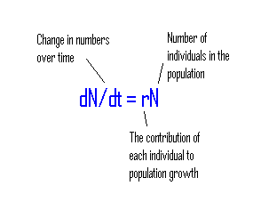
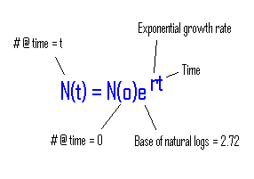
Exponential Equations
The slope of this equation, known in Calculus as its derivative, is:
The exponential population growth equation is usually written in this form:
An equation that tells how a variable changes over time is a differential equation. This one tells us the rate of population growth at any point in time.

Slide 7
Deriving dN/dt = rN
Birth rate:
bN
Number
of individuals:
N
Make a flow diagram (right) showing the influence of all factors on population growth rates:
Express the diagram in words: a change in numbers (N) over time is the difference of the effects of birth (b) and death (d) rates on the population (assume these rates are constant).
Express the words as symbols: dN/dt = bN – dN
Simplify through factoring: dN/dt = N(b – d)
Death rate:
dN
Rearrange and replace: (b – d) with the symbol r, which stands for the overall rate of population growth as influenced by birth and death rates:
dN/dt = rN.

Slide 8
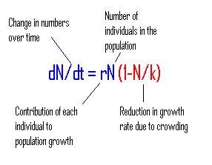
Logistic Growth
The equation that relates the rate of population growth to carrying capacity (the derivative, or instantaneous slope equation) is:
Population growth cannot remain exponential indefinitely. Eventually it slows down as the habitat’s carrying capacity (K: the ability of the habitat to support individuals) is reached:
It is the same as the exponential slope equation except that an additional term (in red) for reduction in growth rate is added.

Slide 9
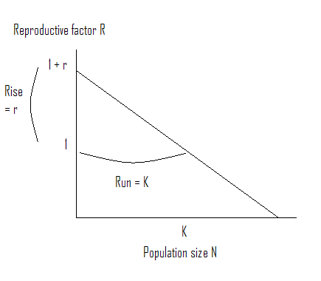
Deriving dN/dt = rN(1-N/K) I
Assume that a population’s reproductive factor R (the number of surviving individuals/ parent) declines linearly:
The growth rate r is maximized when population size is near zero and minimized when carrying capacity K is reached.
At K, each individual in the population just replaces itself (R = 1).
Write this relationship as a linear equation (y = mx + b, or y = (rise/run)x + y intercept): R = – (r/K)N + (1 + r) slope y intercept

Slide 10
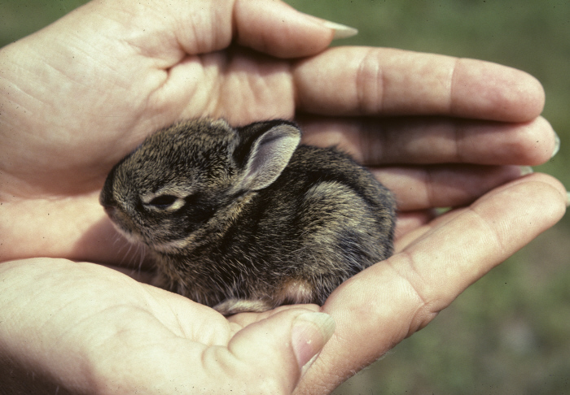
Deriving dN/dt = rN(1-N/K) II
To calculate the change in population over time (dN/dt), we subtract the number in the starting population N from the number at some future time N(t): dN/dt = N(t) – N
N(t) also may be expressed as the product of the reproductive factor R and the starting population N: N(t) = RN
Substituting into dN/dt, we get: dN/dt = RN – N = N(R – 1) factoring
Substituting the formula for R into this, – (r/K)N + (1 + r), gives: dN/dt = N[– (r/K)N + 1 + r – 1]
Fecundity is essential to population growth.
Combining terms gives: dN/dt = N (– rN/K +r)
Factoring and rearranging yields: dN/dt = rN(1 – N/K)

Slide 11
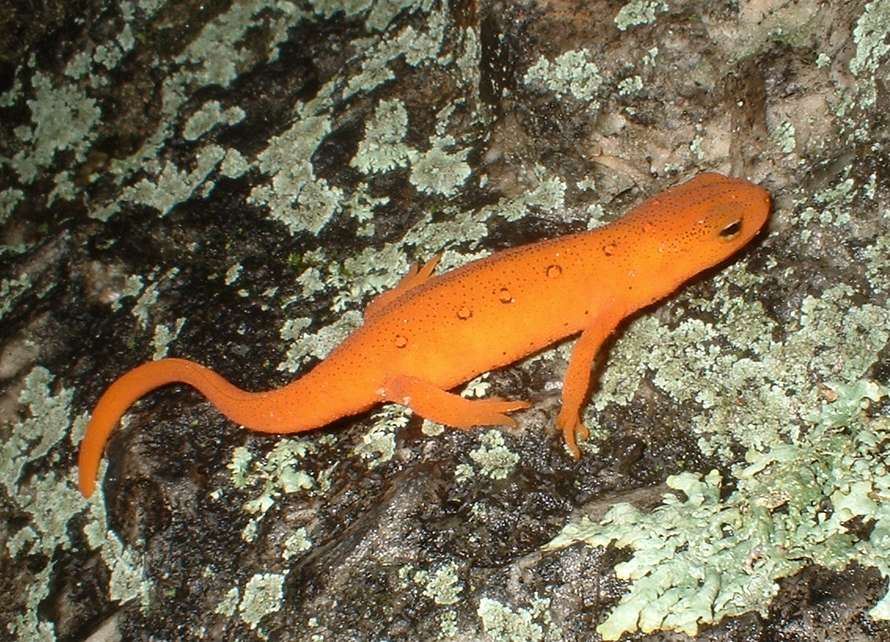
Population Age Structure
Age structure- the number of individuals in each of a population’s age classes.
Population growth rate depends on age structure.
Example: The red-spotted newt (salamander) has two clearly distinguishable age classes, the yellow and tan aquatic adult, and the bright orange terrestrial juvenile (lower left).

Slide 12
Age Structure Diagrams
Notes:
12

Slide 13
Survivorship
Survivorship refers to the proportion of an age class that survives from one time period to the next. There are three typical types.
Type I- high survivorship of early and middle age classes.
Type II- uniform survivorship of age classes.
Type III- low survivorship of early age classes.

Slide 14
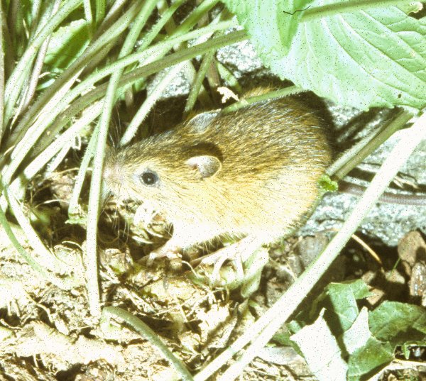
Life Tables
Life tables provide a method for calculating population change over time.
To compute population change, information on survivorship and fecundity (birth rate) in age classes are required.
Age classes for animals like the Snapping Turtle typically are measured in years. Snapping Turtles can live to be nearly fifty years old. Other animals, like the Meadow Jumping Mouse (upper right), generally do not live more than a year.

Slide 15
Life Table Calculations
The table below shows life table calculations for a hypothetical population of Eastern Cottontails:

Slide 16
Immigration and Emigration
Species dispersal in the forms of immigration and emigration exerts significant influence on the trajectories of metapopulations.
Simplistic methods of population estimation like the Lincoln-Peterson method do not consider dispersal- computed as: Total population = (size of the first sample x size of the second sample) / number of marked individuals recaptured in the second sample. It assumes no immigration, emigration, mortality or natality (a closed population), so it is applicable only to single, short-term mark-recapture projects.
In contrast, the Jolly-Seber method- used for multiple mark-recapture studies of open populations- does consider dispersal. Computation involves construction of a data matrix of sampling intervals and individuals captured.
All methods make some assumptions, such as 1) random population sampling, 2) fates of individuals and age classes are independent and 3) there is no loss of markers.
Dispersal is often not considered in population viability models, which limits their reliability.
Tree ferns (understory) are primitive tropical plants that colonize even oceanic island via spores dispersed by wind.

Slide 17
Stochastic Effects
Small populations are more prone to extinction due to genetic and demographic stochasticity.
Furthermore, the greater a population trend’s non-linearity, the greater the effect of random events on it.
Different types of random environmental events like fire or late spring freezes affect demographic parameters differently. Some, for example, may affect birth rate, whereas others may affect juvenile mortality.
Genetic effects may also act on demographic parameters differently.
Incorporating this stochasticity into PVA models has proven difficult and no approach has proven superior.
Modelling sources of population variance is complicated by the limited data available from most rare populations.
United States breeding populations show annual variation but time series decline that best follows a negative power function. Note that variance also declines with population size; i.e. they are autocorrelated.

Slide 18
Birth - Death Models
The basic birth-death model is the simplest approach to estimating extinction probability:
_{N Nm j -1}
E(T) = ∑ ∑ (1/jd_{j}) ∏ (b_{n}/d_{n}),
_{i = 1 j = i n = i}
where E(T) is time to extinction, ∑ ∑ is the sum of the sum of, N is population size, i is a counter from 1 to N, j is a counter from i to N_{m}, N_{m} is maximum population size, ∏ is the product of, d is density-dependent per capita death rate, b is density-dependent per capita birth rate and n is a counter from i from j-1.
This model is sensitive to population size, such that small populations are prone to extinction.
This effect is exacerbated in situations where the population is divided into isolated subpopulations. When dispersal is low, the entire population is prone to extinction.
Environmental stochasticity tends to be more significant a factor in leading to extinction than demographic stochasticity, except in small populations.
Clutch size in Barn Swallows is typically 3-4.

Slide 19
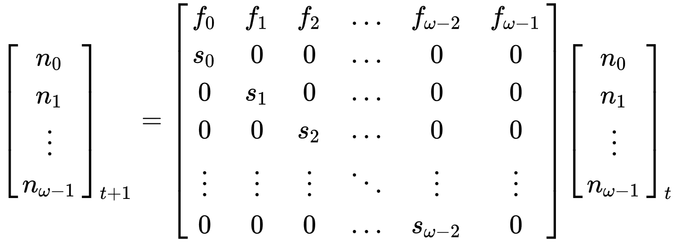
Incorporating Age Structure
Age structure can have a significant impact on population trajectories, so incorporating it into birth-death models improves them.
This can be accomplished by using linear algebra, such as via the computations performed in a Leslie matrix:
This hatching year Carolina Wren is an example of age class 0.
which, using matrix notation, is written as n_{t+1} = Ln_{t}
where n_{w} is the number of individuals in each age class, s_{w} is the proportion of individuals surviving from one age class to the next, f_{w} is the fecundity of each age class, n_{t+1} is the future population, n_{t} is the present population, and L is the Leslie matrix.
For long-lived species, adult survival has a major impact on demography, whereas for short-lived species, fecundity (defined more precisely as the average number of female offspring reaching n₀ from a mother of age class w) has a greater impact.

Slide 20
Ecological Parameters
Although genetic and demographic issues are frequently modeled in PVA, the underlying causes of endangerment are generally ecological ones like habitat destruction, overharvest and pollution.
Moreover, community parameters such as interspecific interactions also affect population trajectories by individual species.
Such parameters are less considered in PVA models yet, as we have seen, particularly stochastic environmental perturbations like fire or storms can have catastrophic effects on small populations.
The density and spatial configuration of habitat patches and the dispersal ability of species are also significant factors in influencing population viability. These may also be modeled using linear algebra techniques.
A Markov chain is such a procedure. It is a stochastic model that describes a sequence of possible events in which the probability of each event is determined only by the state attained in the previous event.
Stochastic environmental phenomena like that caused by tornadoes can be catastrophic for small populations even if other factors were principally responsible for bringing about endangerment.

Slide 21
Minimum Viable Populations
This is the minimum population that can persist in the face of genetic, demographic and environmental stochasticity.
It is evaluated differently, although it is typically defined as the 95% probability that a population can persist for >100 years.
PVA simulations are used to estimate this number.
As we have seen, there are multiple variables responsible for determining population trajectory and modeling these variables is difficult, particularly for small populations. Hence, the accuracy of these estimates tends to be limited.
Estimates for terrestrial vertebrates are generally >500 individuals, although incorporation of such phenomena as inbreeding depression tends to raise minimum estimates into the thousands.
The arctic-alpine Potentilla tridentata exists in isolated populations on the highest mountaintops in New England with limited dispersal between populations, yet it has persisted in these locations since the end of glacial times.

